Slide 1
Network Based API
Presenters : Anupriya, Kislay, Sulabh
May 21, 2020

Slide 2
What is an API ?
An application programming interface (API) is a specification intended to be used as an interface by software components to communicate with each other. An API may include specifications for routines, data structures, object classes and variables.
Consumer Program
API Interface
Provider Program

Slide 3
API Typology :

Slide 4
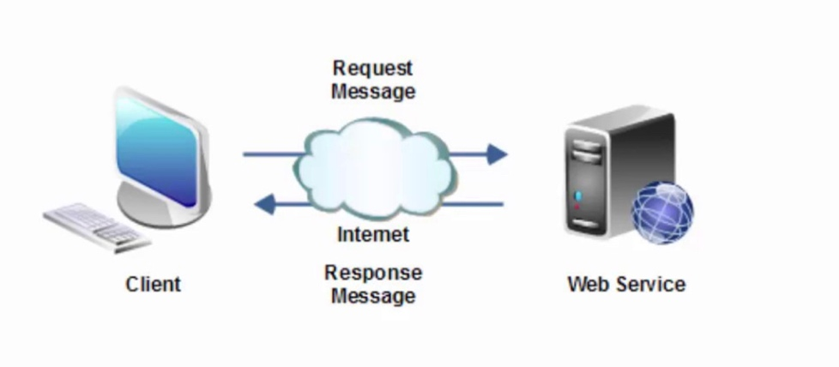
API Transition:
Three Transition Happens in an API
Request – A request is Made something to be Done.
Program - A program is run to complete the request.
Response – A program sends back the response.

Slide 5
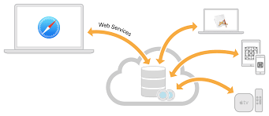
Web Service:
What is a web service?
Web = Internet
Service = API
Web Service = API that uses Internet
So, all web services is an API.
But not all API’s are web services. Not all API’s use the internet.
Web Services use:
XML or Json to format the data over the internet.
Rest, SOAP, or XML/RPC to transfer that data.

Slide 6


What happens on Google Search ??
Simple Google Search –
For instance from Client we made a request to search information on “Python”.
Client sent request to Google program to search a term called “Python”
Google program Executes and sends a response of the Term Python in the form of Webpage or HTML.

Slide 7
Want to know more??
When request is Made from the Client to the Google Program,
Program lies in www.google.com
Based on the type of request made , Google program goes to the specific directory to perform the action(On our Example it’s “Search”)
So google program will execute the request in www.google.com/search
So once we get to the right directory, Parameters is added to Query the term the client is looking on.
www.google.com/search?q=python
Once we add the parameter , Response is sent to the client.

Slide 8
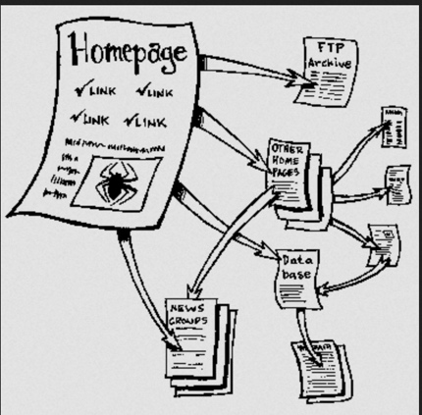
HTTP???

Slide 9

HTTP METHODS???

Slide 10
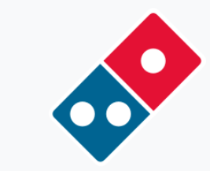
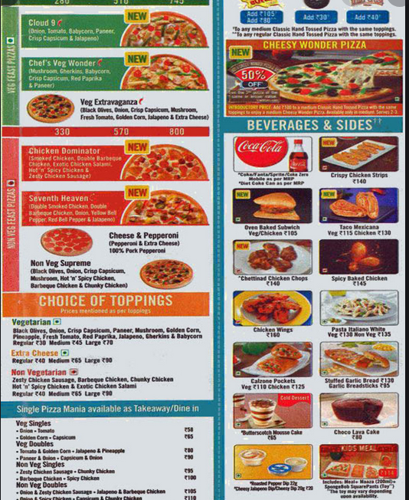
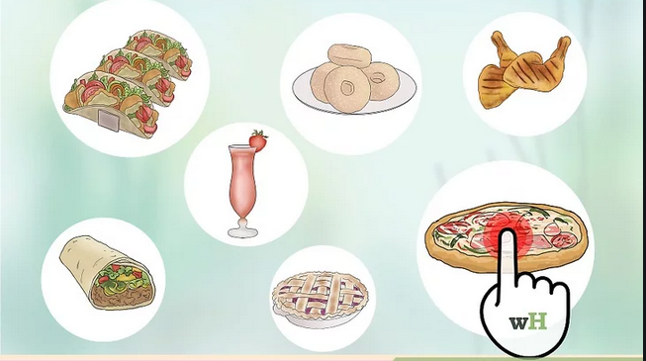
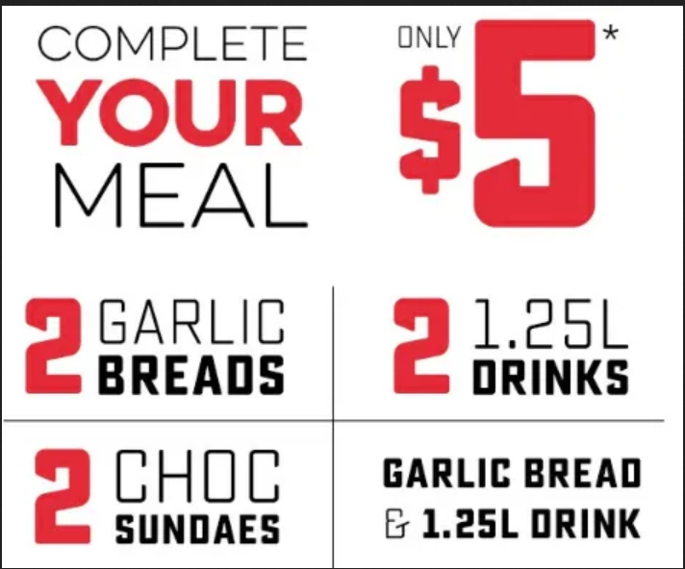
FEELING HUNGRY?
Can I change my order please???

Slide 11
FEELING HUNGRY?
GET
POST
PUT / PATCH / DELETE
Can I change my order please???

Slide 12
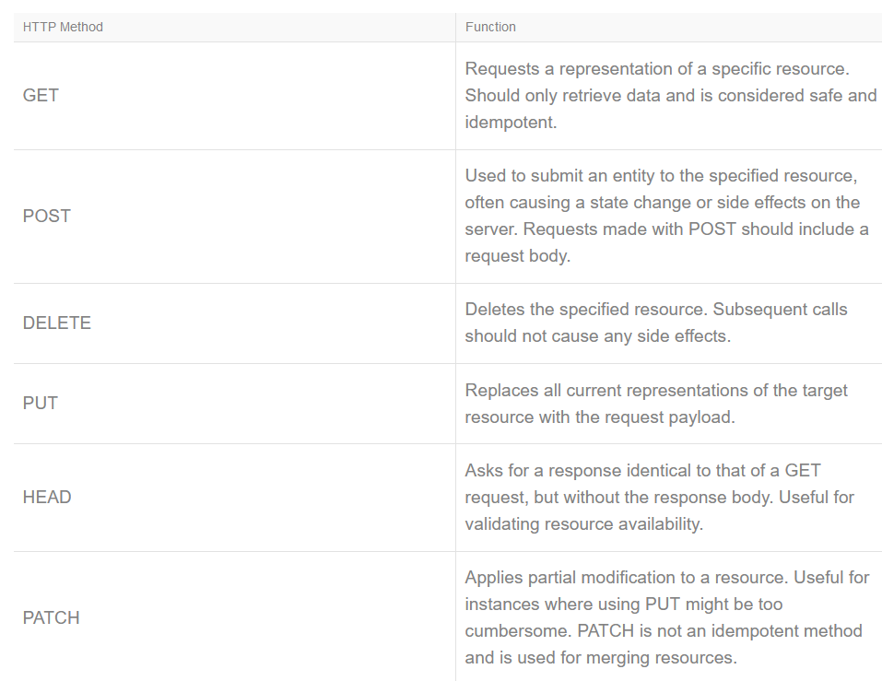

Slide 13
Go to menti.com and enter the code 54 08 99 or https://www.menti.com/wougzdinxs
From the above example, what HTTP method would you use to place an order in a restaurant?
GET
POST
DELETE

Slide 14
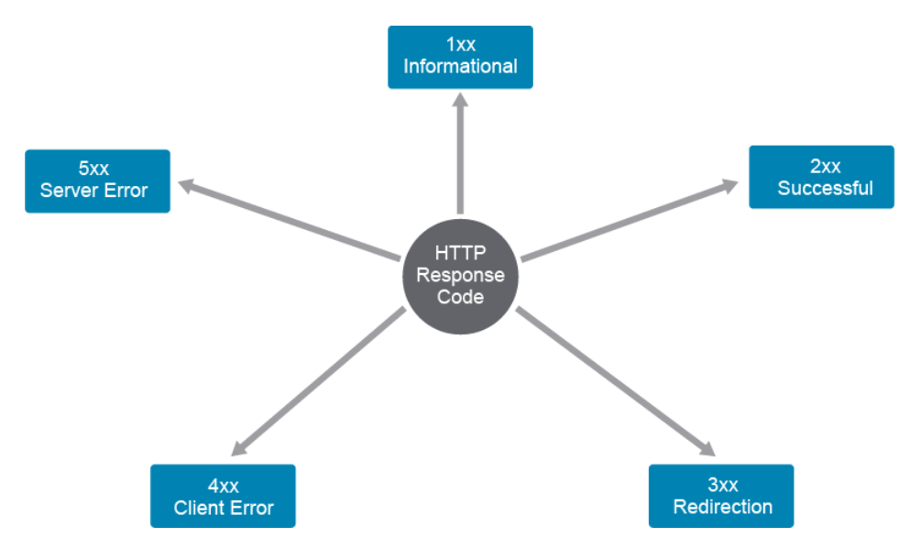
HTTP Status Code
200 | OK
201 | Created
204 | No content
300 | Moved Permanently
302 | Not Found
304 | Not modified
400 | Bad Request
401 | Unauthorized
403 | Forbidden
404 | Not Found
500 | Internal Server Error
501 | Not Implemented
503 | Service Unavailable

Slide 15
Headers
General Header
Cache-control | Specifies caching parameters
Connection | Defines connection persistency
Date | A datetime time stamp
Response Headers
Age | Conveys the amount of time since the response was generated
Location | Used to redirect the client to a location other than the request URI from a header
Server | Contains the information about the software used by the origin server to handle the request
Set-Cookie | Used to send cookies from the server to the client.
Request Headers
Accept | A subset of headers that define the preferred response format
Authorization | Method of authentication
Cookie | Contain user information
Host | Specify internet host and port
User-Agent | Contains the information about the user agent originating the request

Slide 16
Headers
Entity Headers | contain information about the response body
Allow | Lists the supported methods identified by the requested resource
Content-Type | Type of content
Content-Language | Describes the language of the intended audience for the enclosed body
Content-Length | Indicates the size of the body in bytes
Content-Location | Used to supply the resource location for the entity that is accessible from somewhere else than the request URI
Expires | Gives the datetime after which the response is considered stale
Last-Modified | Indicates the date and time at which the origin server believes the variant was last modified

Slide 17
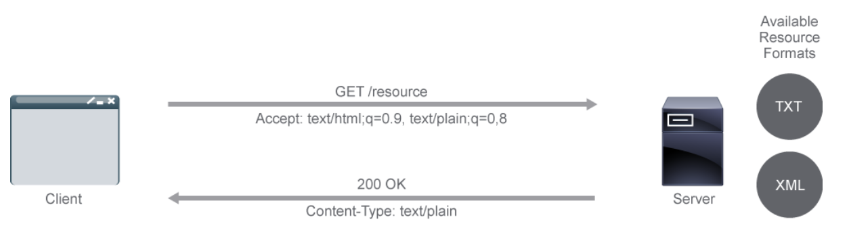
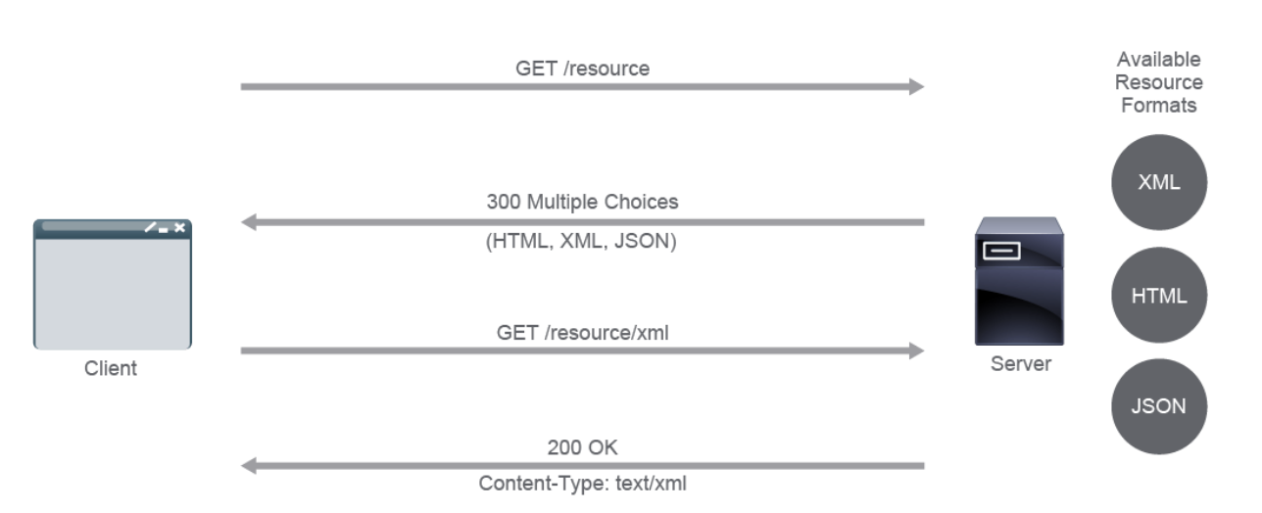
Server Driven vs User-Agent Driven Content Negotiation
Server Driven
User-Agent Driven

Slide 18
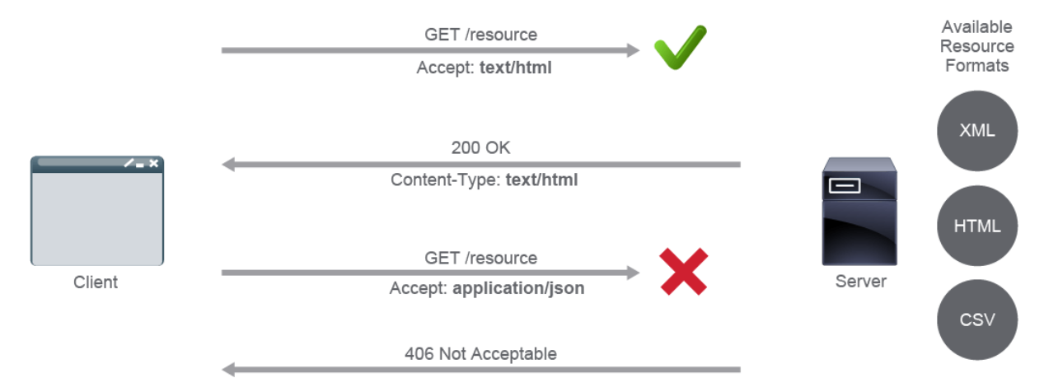
HTTP Content Negotiation
Accept header
Not-accepted: 406 status code

Slide 19
Header used for Content-Negotiation
Accept
Application(binary data e.g. json, xml)
Audio
Image
Text
Video (human readable like text, csv, html, etc.)
Accept-charset (character encoding)
Accept-datetime (request a previous version of resource)
Accept-encoding
Accept-language (Accept-Language: en-US, en-GB;q=0.9, en-IN;q=0.8, *;q=0.7)

Slide 20

Getting Started with Postman

Slide 21
INSTALLATION
Go to Postman.com -> Download The App.
Download the Linux, Windows based for your system. Please don’t use the chrome extension now since it being deprecated and no. longer up-to date.
RESTful APIs are everywhere nowadays but at the same time they are getting more complex to get started with: different HTTP methods, headers, cookies, dealing with file uploads or authentication with api keys, tokens, OAuth and so much more.
But before you start investing time writing code to retrieve the data the API is offering, why not test the request first to make sure everything is working as expected?
This is where the Postman App comes in.

Slide 22
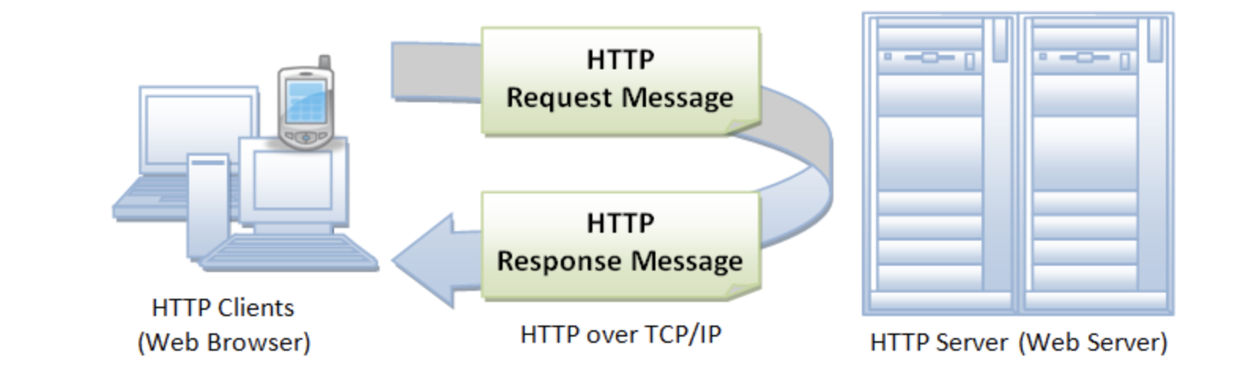
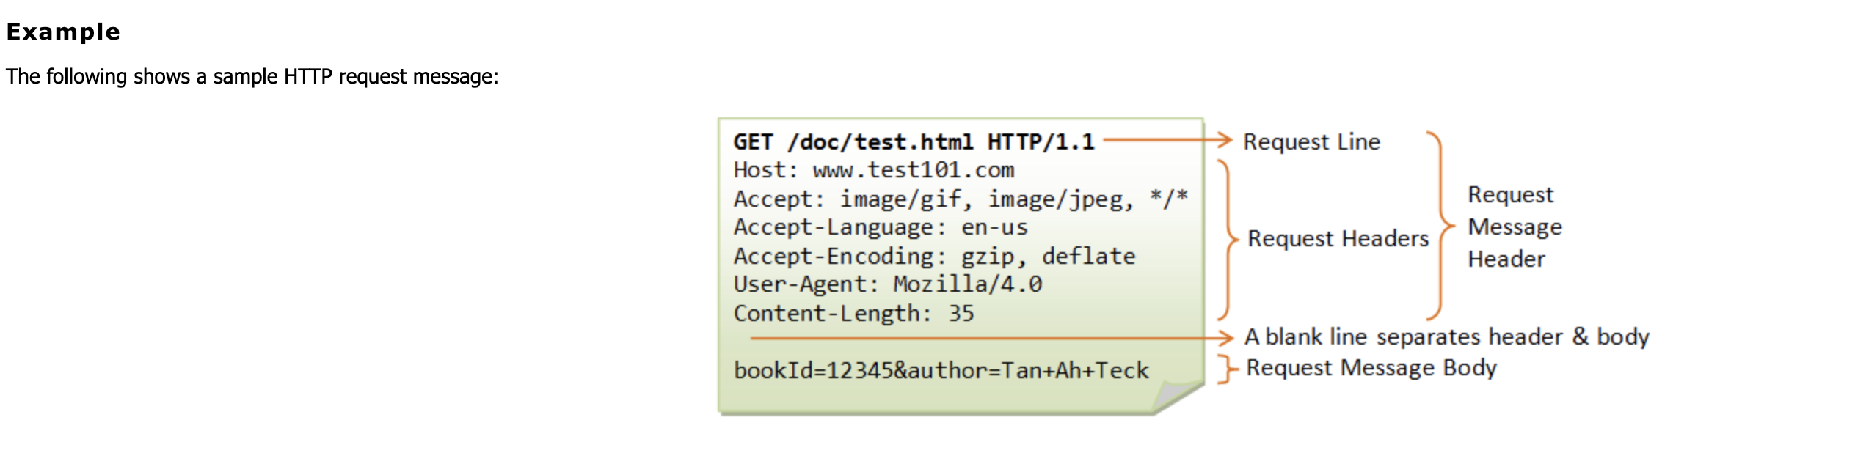
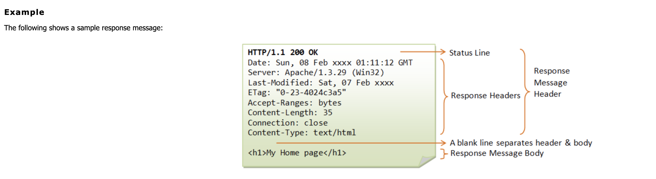
HTTP Client-Server

Slide 23
First Request
httpbin.org/get
Passsing data with your requests
httpbin.org/get?name=John&age=30
Headers
You can customize your headers. (X-Sulabh: Agarwal)
Debugging Requests
Open Postman Console.

Slide 24
Path Variables(or Path Parameters)
httpbin.org/status/200
httpbin.org/status/:status?name=John
Authentication
httpbin.org/bearer -> Unauthorized, since server expects some
credentials with my request.
A new header gets added “Authorization Bearer Token Value”.
Save & Share Requests

Slide 25
Creating a Post Request with Json Body
httpbin.org/post
httpbin.org/status/:status?name=John
Save & Share Requests
Using Variables in Postman
Variables can be used to pass information between requests.
Generating Dynamic Data in Requests.

Slide 26
Webhooks
What is webhook?
Why we use webhook?
Regular API vs Reverse API?
Webhooks and Cisco Spark

Slide 27
What is webhook?
So, what exactly is a webhook? A webhook (also called a web callback or HTTP push API) is a way for an app to provide other applications with real-time information.
Any data change is pushed by the server to the client.
POST is used to register a webhook and Post is used send the notification
Listener is need to listen to webhook notifications
The targetUrl should be accessible by the server.

Slide 28
Why Webhook?
The job of the APIs is not only to server static data but to provide the changes in data too.
A change in any data should be known to the user.
The other option is to continuously ask the server is there any change in data.
This wastes the bandwidth and resources of the server.
Hence the webhook where server notify the changes to the client.
But how does the server know where the client is and is the client listening?

Slide 29
Regular API vs Reverse API?

Slide 31
Demo & References
https://developer.webex.com/docs/api/guides/webhooks
https://developer.github.com/webhooks/

Slide 32
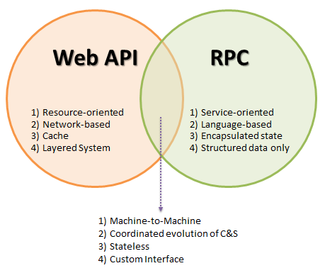
RPC ??

Slide 33
Remote Procedure Call:
Remote Procedure Call (RPC) RPC is the simplest form of API interaction.
It is about executing a block of code on server and when implemented in HTTP it can become a Web API.
RPC API is only a style of building an API
RPC supports notifications like sending data to the server that does not require a response, which is useful for asynchronous updates and batch requests (multiple requests inside one request body).

Slide 34
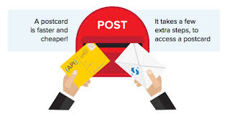
SOAP ??

Slide 35
Simple Object Access Protocol:

Slide 36
Example:

Slide 37
JSON-RPC:
JSON-RPC is a very simple and lightweight RPC protocol encoded in JSON that defines only a few primitive data types,
such as string, integer, Boolean, and null, and commands such as params, method, id

Slide 38
XML-RPC:
XML-RPC is a protocol that is similar to SOAP. However, it is less structured and uses fewer constraints than SOAP.
In addition to the basic data types, it also supports some more complex types like Base64, array, datetime, and struct.

